Slide 1
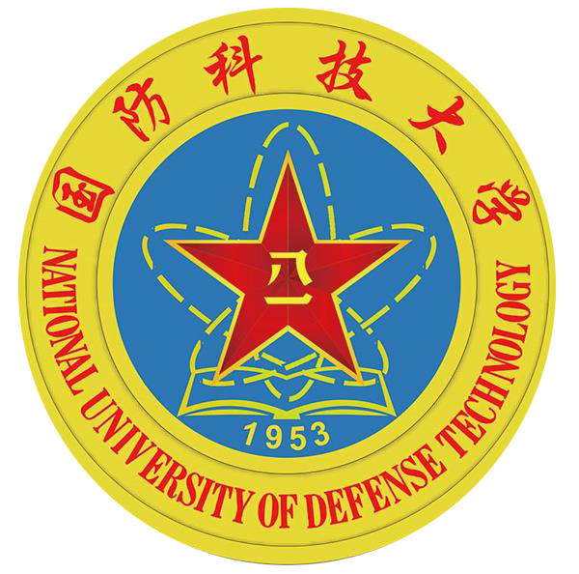
NVLH: Efficient and Crash-consistent Linear Hashing
for Non-Volatile Memory
Hu Wan*, Fuyang Li*, Zimeng Zhou*, Kaisheng Zeng†, Jianhua Li‡, Chun Jason Xue*
*City University of Hong Kong † National University of Defense Technology ‡Hefei University of Technology
Linear Hashing
Non-volatile Memory (NVM)
Linear hashing is a dynamic hashing scheme widely used in modern database management systems
  Stable performance and high storage utilization
  Index file grows and shrinks gracefully: one bucket at a time
However, ensuring the persistency and consistency of linear hashing indexes is non-trivial in disk-based systems
  Rebuild linear hashing indexes from disk is slow
 | DRAM | HDD | SSD | NVM
Access Time | 55ns | 3ms | 25-200μs | 50-150ns
Non-Volatile | No | Yes | Yes | Yes
Granularity | Byte | Block | Block | Byte
NVLH is a persistent and consistent linear hashing scheme for NVM
  NVLH leverages direct access feature and user-level flushing for persistency support
  NVLH provides log-based durable transaction for crash consistency support
Linear Hashing Example
Illustration of the expansion process of linear hashing:
An initial linear hashing file with 8 keys
Insert of 21 causes a collision and split of bucket 0
Keys 16, 14, 19, and 20 inserted; insert of 23 causes split of bucket 1
Keys 17 and 32 inserted; insert of 27 causes split of bucket 2
Insert of 25 causes split of bucket 3
NVLH Design
A. System model
  Direct Access (DAX) allows applications to access NVM directly via mmap()
  File systems DAX (w/o user-level flushing) / Device DAX (w/ user-level flushing)
  B. Low-level persistence support
  CPU cache line flush: CLFLUSH, or CLFLUSHOPT/CLWB + memory fences
  Asynchronous DRAM refresh (ADR)
  C. Durable transaction
  Undo log-based transaction
  D. Persistent object addressing
  Naming mechanism
  Position independent persistent object address translation
  E. Dynamic memory management
  malloc/free style non-volatile memory allocation
  Two-phase non-volatile memory allocation
  Implementation / API:
  create/insert/delete/query/destroy
NVLH System Stack
Results
Experimental setup
  NVDIMM and emulated NVM w/ 100-500ns write latency
  Compared with double hashing w/ atomic updates (DH-ATM) and durable transaction (DH-TXN)
  Performance
  NVLH improves insertion, deletion, and query performance by 1.28x, 1.31x, 1.21x, and 1.31x, 1.34x, 1.0x, respectively, compared to DH-ATM and DH-TXN
  Maximum Latency
  NVLH provides a significant responsiveness advantage versus DH-ATM and DH-TXN
IEEE Non-Volatile Memory Systems and Applications Symposium (NVMSA 2018)
Contact: hu.wan@my.cityu.edu.hk

